Slide 1
Artificial Intelligence Chapter 1: Introduction
Prof.E.Sreenivasa Reddy
Professor-HAG

Slide 2
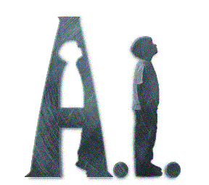
Artificial Intelligence
Intelligence is nothing but common sense
Left behind after eliminating
Nuisance

Slide 3
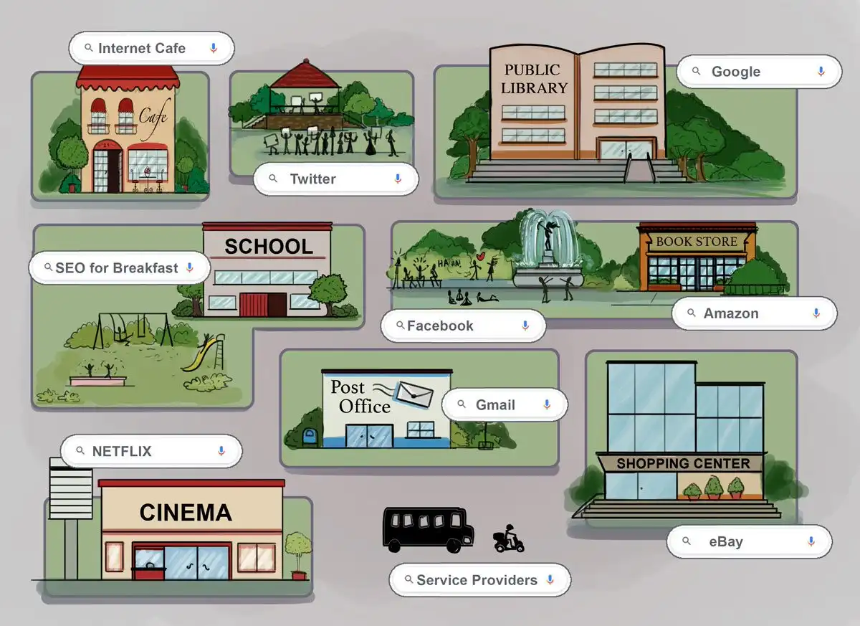
Think about Before INTERNET -
After INTERNET

Slide 4
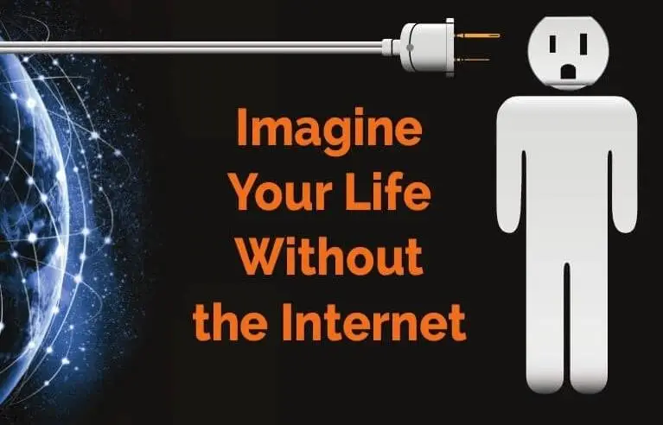
As we need
Air
Water
Electricity
For our day to day living
We need today
INTERNET

Slide 5
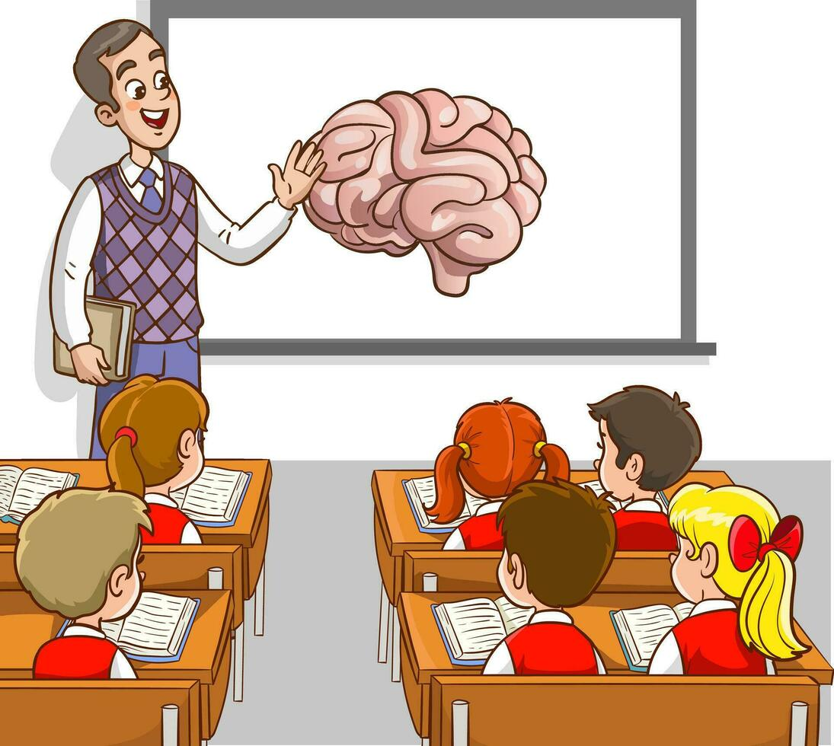

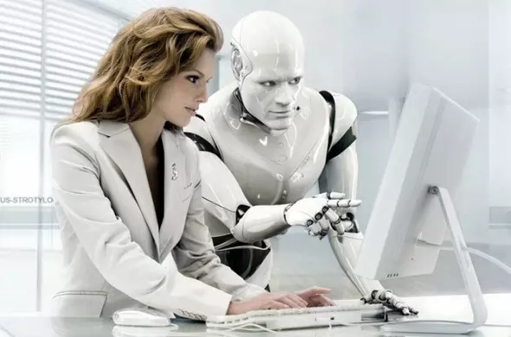
Think about
Before AI
After AI

Slide 6
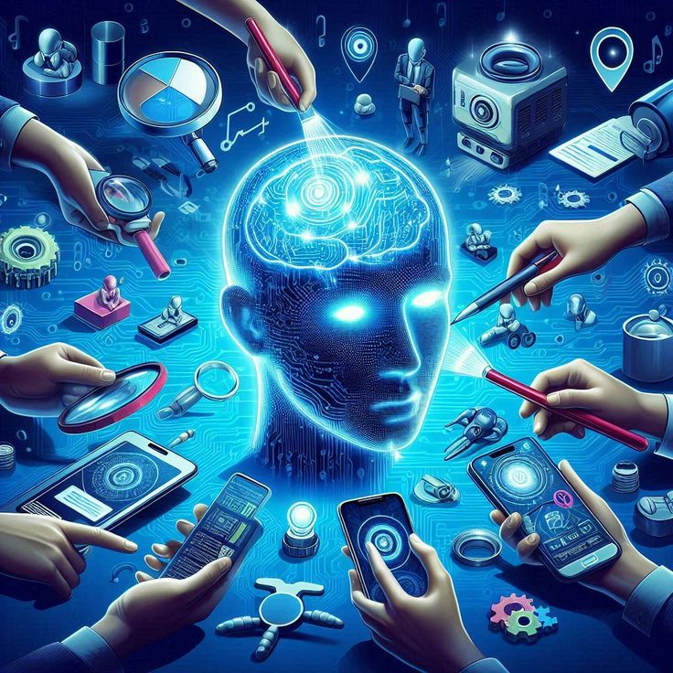
As we need
Air
Water
Electricity
INTERNET
For our day to day living
We need today
ARTIFICIAL INTELLIGENCE

Slide 7
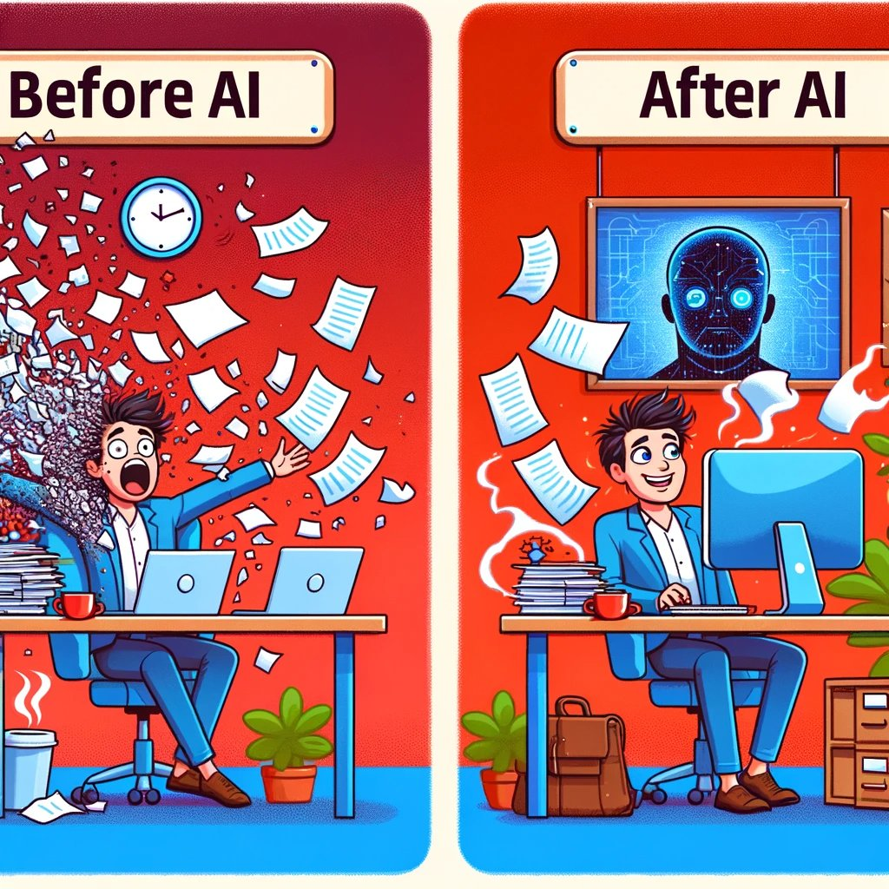

Slide 8
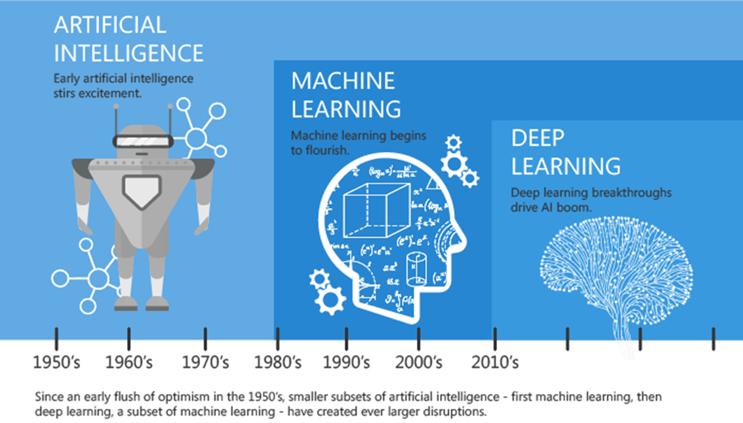
https://blogs.nvidia.com/blog/2016/07/29/whats-difference-artificial-intelligence-machine-learning-deep-learning-ai/

Slide 9
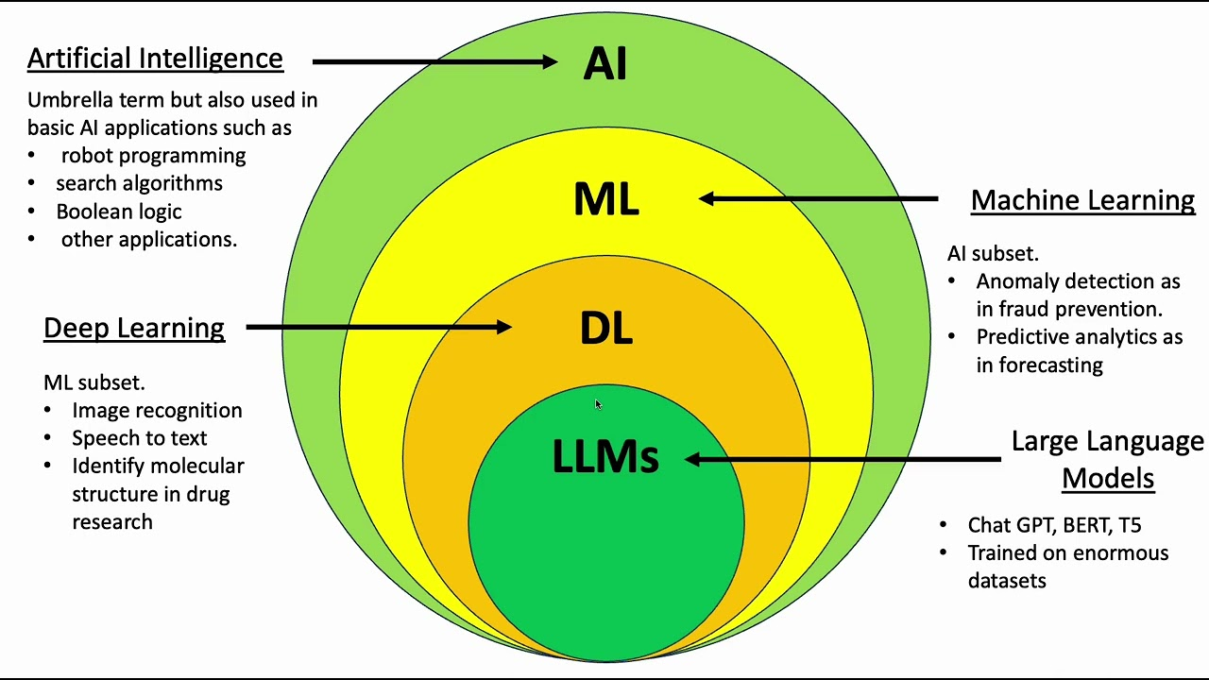

Slide 10
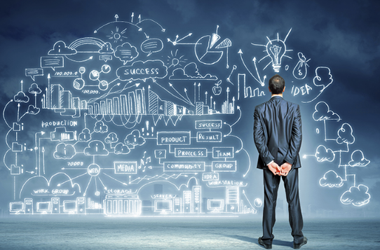
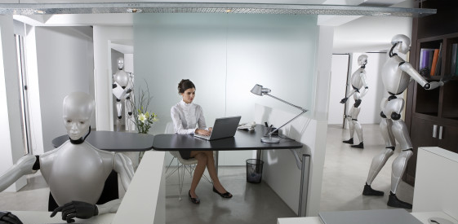
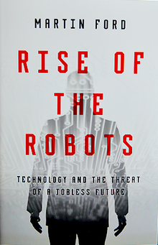
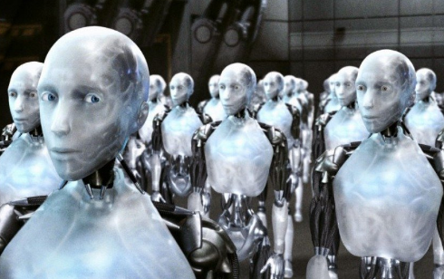
AI Impact
Economic, cultural, social, … endless disruption
Labour - McKinsey 58% of jobs automated
Martin Ford, Rise of the Robots
Elon Musk, artificial intelligence... existential threat
Notes:
SRC: NewsSRC: News

Slide 11
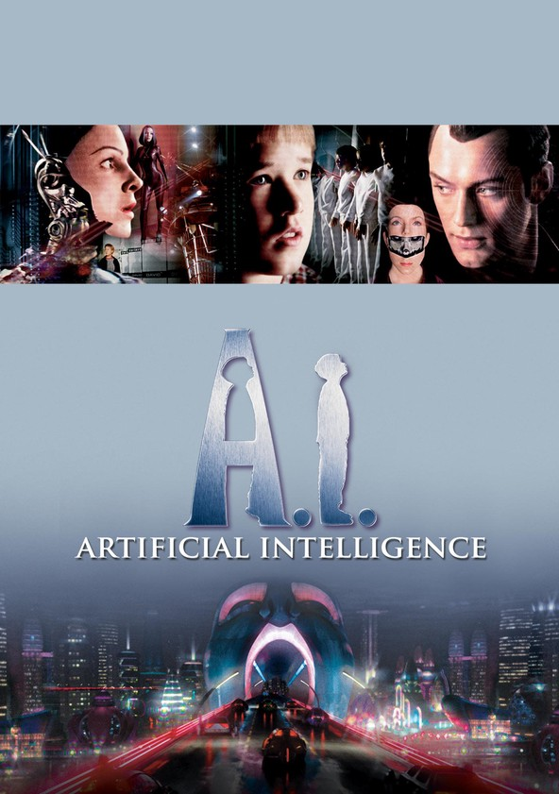
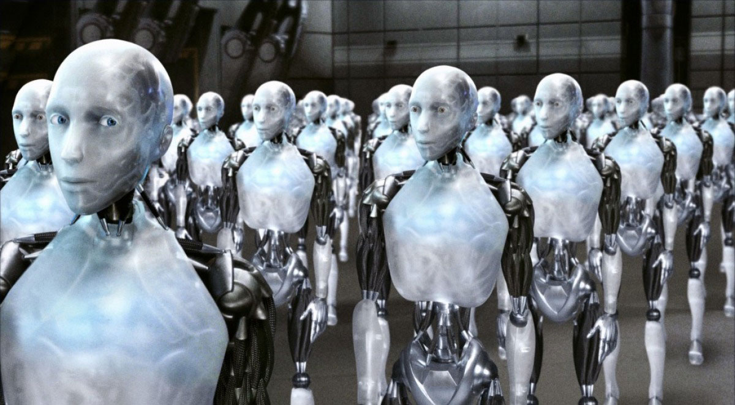
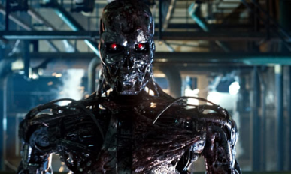
AI in Fiction
I Robot film based on Novel I, Robot
Artificial Intelligence film based on novel AI
An intelligent killing robot

Slide 12

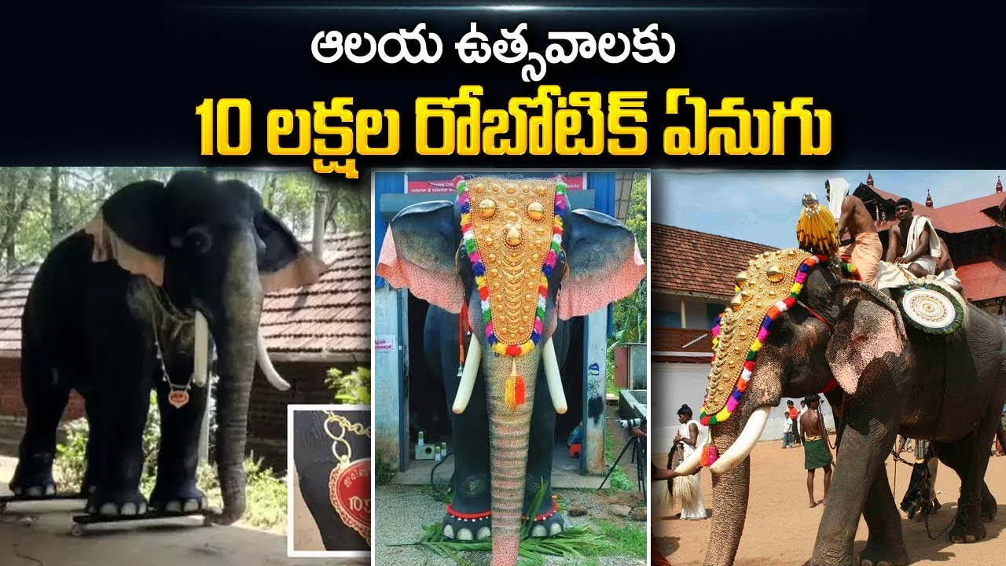
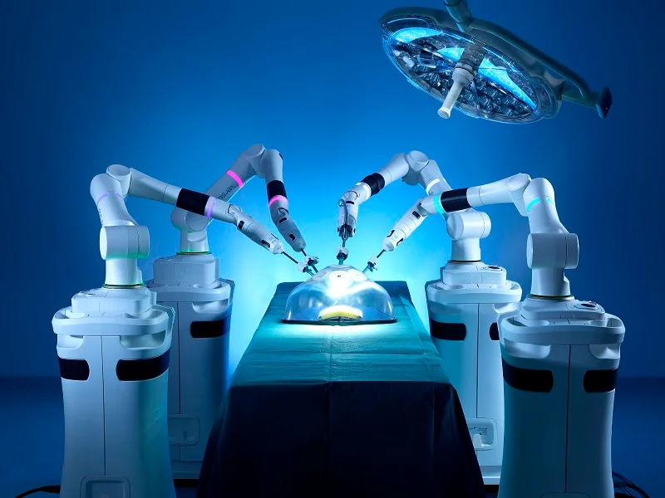
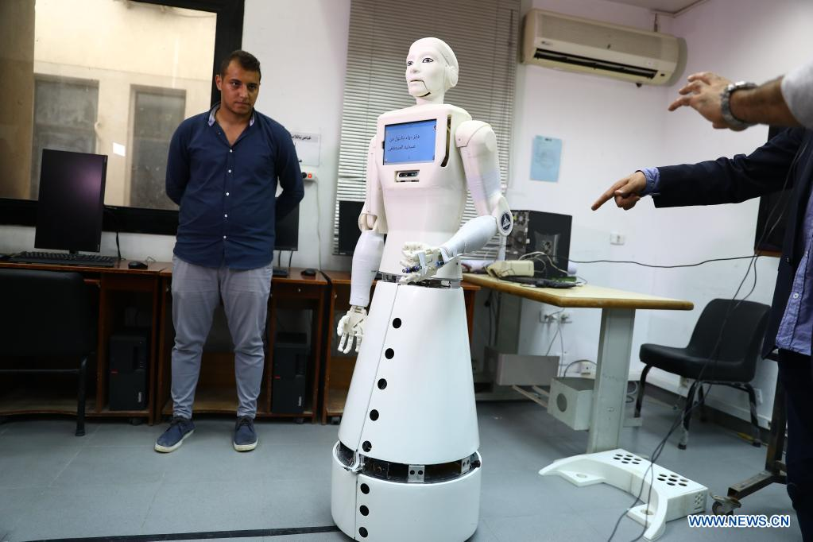
AI in Reality
AI Anchor
AI Elephant
Robotic surgery
Robotic Nurse

Slide 13
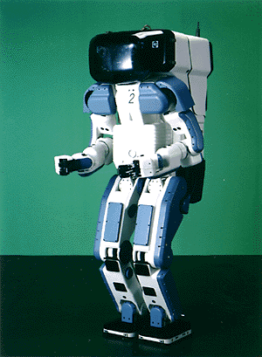
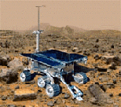

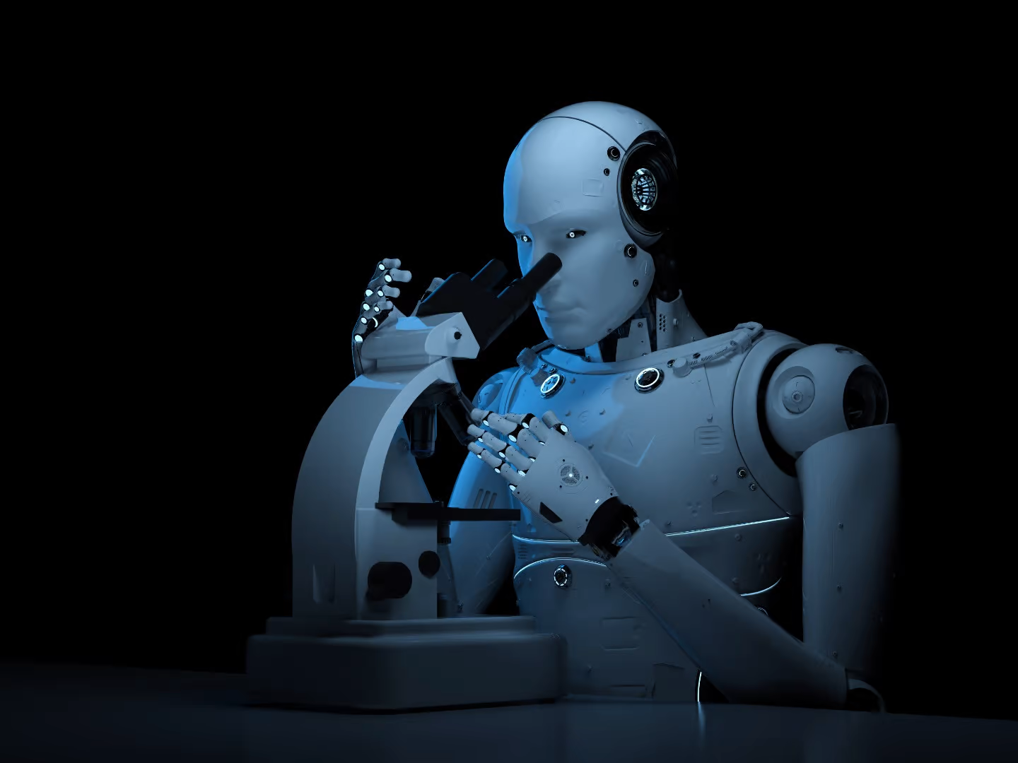
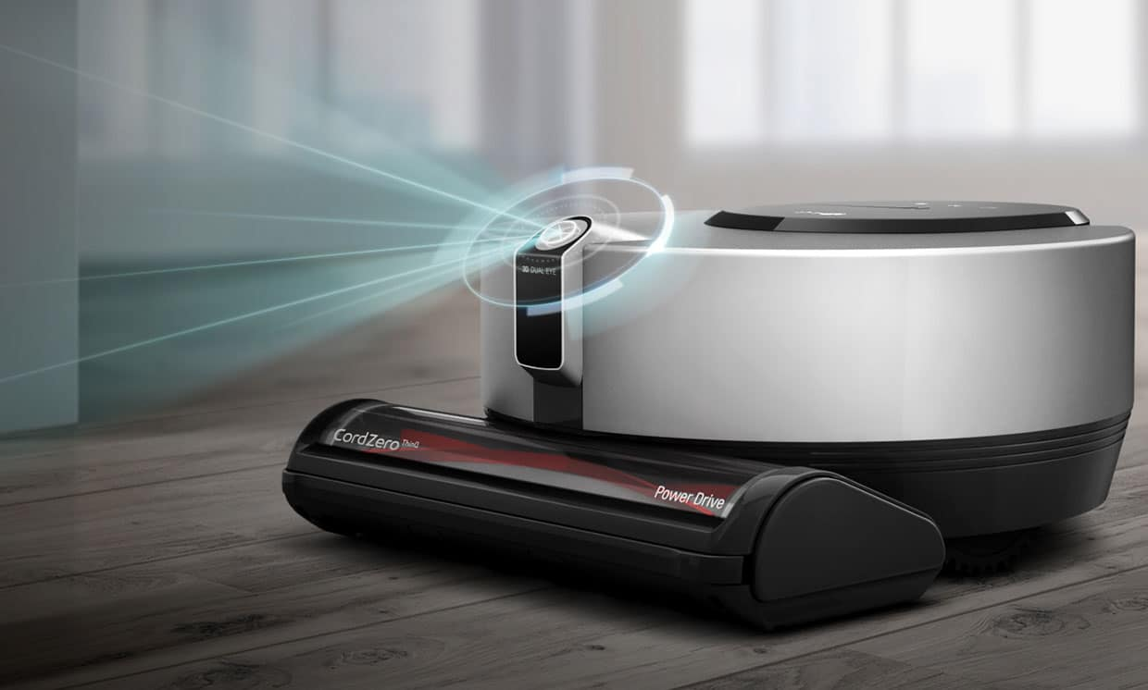

What’s interesting with AI
Search engines
Science
Labor
Appliances
Medicine/
Diagnosis
Movies Recommendation

Slide 14
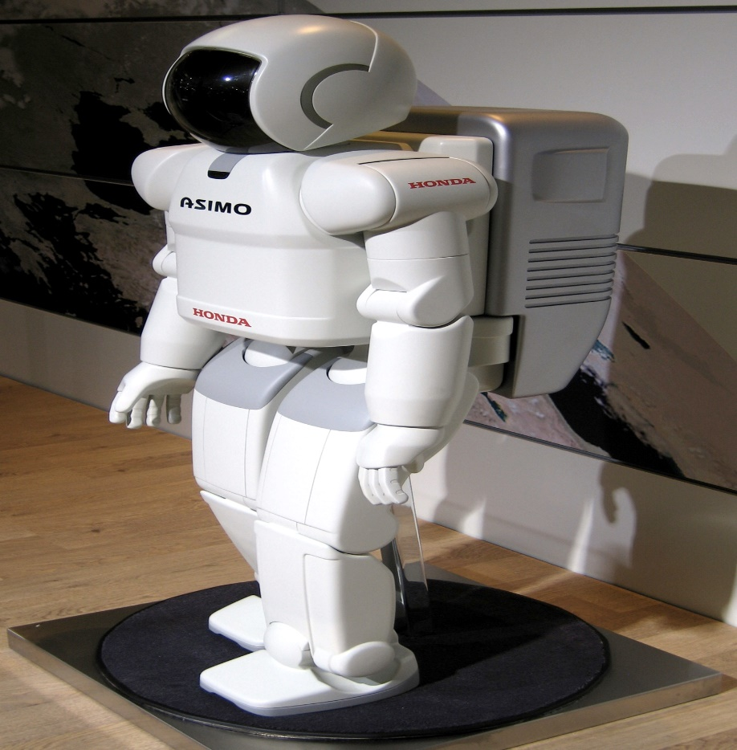
What’s interesting with AI
Honda AISMO
Advanced Step in Innovation Mobility
Humanoid Robot
Capable of recognizing:
Moving objects
Postures
Gestures
Handshake
Sounds
Capable of walking and running
http://en.wikipedia.org/wiki/ASIMO

Slide 15
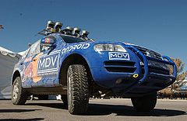
What’s interesting with AI
Darpa Grand Challenge
To nurture the development of autonomous ground vehicles
Competition of Driverless vehicles
2004
1 million
Mojave Desert
Follows a route of 240 km
No one won: best completed 12 km
2005
2 million dollar prize
3 narrow tunnels, 100 sharp turns
Twisted pass with a drop-off one one side
Five succeeded
Winner: 6:54 hours, Stanford Racing Team – Stanely
Urban Grand Challenge
2007
2 million dollar
AirForce Base
To obey to all traffic rules
96 km within less than 6 hours
CMU team won – with 4:10
stanely
http://en.wikipedia.org/wiki/DARPA_Grand_Challenge

Slide 16
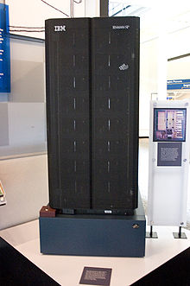
What’s interesting with AI
1996, Deep Blue first machine to beat chess world champion
But lost in the series – 4 to 2
1997, won the series 3.5 to 2.5
Search 6 to 8 moves a head
The evaluation function is set by the system after examining thousands of master games
http://en.wikipedia.org/wiki/Deep_Blue_(chess_computer)

Slide 17
Best AI Certifications to Land a High‑Paying Job in 2025
Free AI courses for high-paying jobs
Neural Networks – ML Concepts by Google for Developers
Introduction to Computer Vision and Image Processing – IBM, via Coursera (Financial aid available)
Machine Learning Crash Course – Google for Developers
Intro to PyTorch and Neural Networks – Codecademy (Certificate requires a paid subscription)
Machine Learning Specialization – Andrew Ng, via Coursera
Applied Machine Learning in Python – University of Michigan, via Coursera
Deep Learning Lecture Series 2020 – DeepMind & UCL, available on YouTube

Slide 18
Data
Data vs. Information
Data
Collection of raw facts in any form
Either text, numerical ,signals, etc
Data can exist in a variety of forms -- as numbers or text on pieces of paper, as bits and bytes stored in electronic memory, or as facts stored in a person's mind.
Strictly speaking, data is the plural of datum, a single piece of data

Slide 19
Information
Information
A collection of facts organized in such a way that they have additional value beyond the value of the facts themselves.
The information is obtained by assembling items of data into a meaningful form.
For example, marks obtained by students and their roll numbers form data, the report card/sheet is the . information. Other forms of information are pay-slips, schedules, reports, worksheet, bar charts, invoices and account returns etc.
Information can be considered as processed data
Processing: Processing means searching, sorting, merging etc

Slide 20
Knowledge
Knowledge
An awareness and understanding of a set of information and how that information can be made useful to support a specific task
The fact or condition of knowing something with familiarity gained through experience or association
means of knowledge: perception , inference , comparison , and sound, or testimony
Knowledge base
The collection of data, rules, procedures, and relationships that must be followed to achieve value or the proper outcome

Slide 21
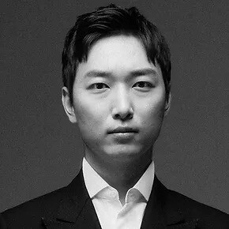
What is Intelligence?
The ability to learn or understand or to deal with new or trying situations :
REASON; also : the skilled use of reason
the ability to apply knowledge to manipulate one's environment or to think abstractly as measured by objective criteria (as tests)
the ability to solve complex problems or make decisions with outcomes benefiting the actor
There are four types of intelligence that are commonly used today;
Intelligence Quotient (IQ)
Emotional Quotient (EQ)
Social Quotient (SQ)
Adversity Quotient (AQ)
YoungHoon Kim (IQ 276)

Slide 22
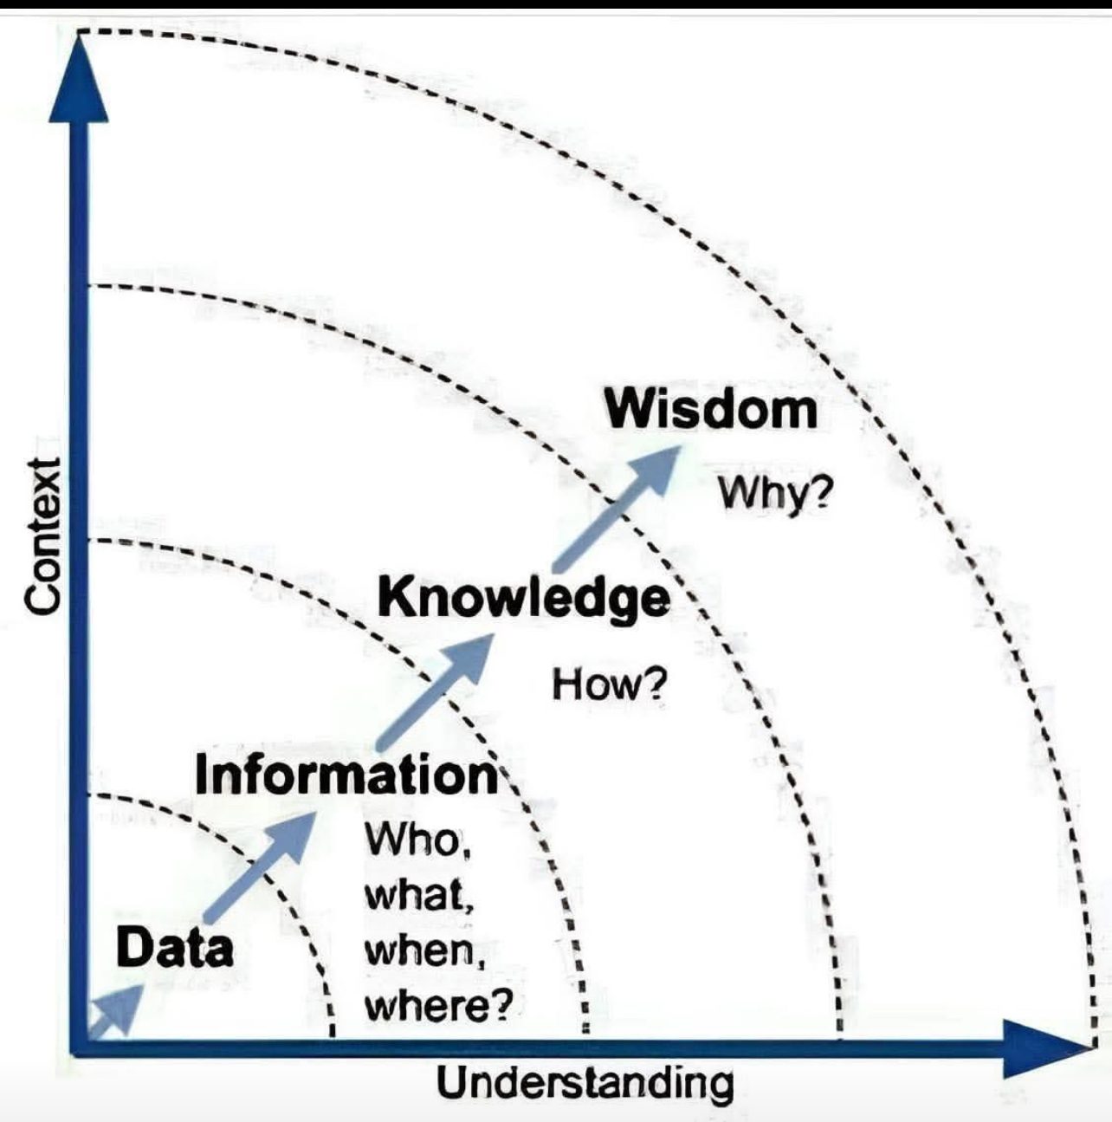

Slide 23
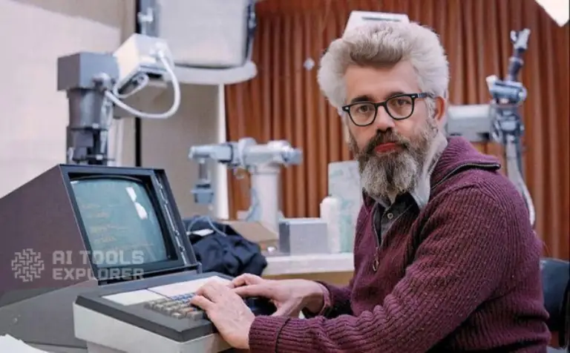
Historical Definition of AI
“The study of the conjecture that every aspect of learning or any other feature of intelligence can in principle be so precisely described that a machine can be made to simulate it.”
Dartmouth Workshop, Summer of 1956
John McCarthy is widely regarded as the "father of artificial intelligence" (AI). He is credited with coining the term "artificial intelligence" in 1956

Slide 24
What is Artificial Intelligence?
Not just studying intelligent systems, but building them…
Psychological approach: an intelligent system is a model of human intelligence
Engineering approach: an intelligent system solves a sufficiently difficult problem in a generalizable way
Artificial intelligence (AI) is the intelligence of machines or software, as opposed to the intelligence of human beings or animals. AI applications include advanced web search engines (e.g., Google Search), recommendation systems (used by YouTube, Amazon, and Netflix), understanding human speech (such as Siri and Alexa), self-driving cars (e.g., Waymo), generative or creative tools (ChatGPT and AI art), and competing at the highest level in strategic games (such as chess and Go)
Notes:
“AI” coined in 1956! (50th year retrospective issue of AIM)
AAAI (american association…) created in 1980 (25th anniv issue)
[computer as test subject for theory of cognition] // [does it scale up? - “blocks world” pejorative
Think vs. Act Rational vs. Human

Slide 25
Definition of AI
“The science and engineering of making intelligent machines, especially intelligent computer programs” – John McCarthy
Artificial Intelligence is a way of making a computer, a robot, or a software think intelligently, in a manner similar to intelligent humans think.

Slide 26
AI – Alternative Definitions
Elaine Rich and Kevin Knight: AI is the study of how to make computers do things at which, at the moment, people are better.
Stuart Russell and Peter Norvig: [AI] has to do with smart programs, so let's get on and write some.
Claudson Bornstein: AI is the science of common sense.
Douglas Baker: AI is the attempt to make computers do what people think computers cannot do.
Astro Teller: AI is the attempt to make computers do what they do in the movies.

Slide 27
Need for AI
There are numerous reasons for us to study AI.
AI can learn through data
AI can teach itself
AI can help us understand what “intelligence” means

Slide 28
What is Intelligence?
The ability of a system to
Perceive the environment
Calculate & reason from the percepts
Learn from experience
Store and retrieve information from memory
Solve problems, comprehend complex ideas
Use natural language ﬂuently
Classify, generalize, and adapt to new situations.

Slide 29
Types of Intelligence
Linguistic Intelligence
Musical Intelligence
Logical-Mathematical intelligence
Spatial intelligence
Soft skills
etc

Slide 30
Signs of Intelligence
Perception
Reasoning
Learning
Problem Solving

Slide 31
Reasoning
Inductive Reasoning
Making generalizations from specific observations
Kamala is a teacher. Kamala is hardworking. Therefore, all teachers are hardworking!
Deductive Reasoning
Start with a general statement and reach a specific conclusion
All women > 60 are grandmothers. Kamala is 65. So Kamala is a grandmother.

Slide 32
Learning
Auditory learning
Episodic learning
Motor learning
Observational learning
Perceptual learning
Relational learning

Slide 33
Other Types of Learning
Supervised learning
Unsupervised learning
Reinforcement learning

Slide 34
Problem Solving
It is the process in which one perceives and tries to arrive at a desired solution from a present situation by taking some path, which is blocked by known or unknown hurdles.
It is the process of decision making, which involves selecting the best alternative out of multiple alternatives to reach the desired goal.

Slide 35
What is involved in an AI Course?
Searching
Logic
Knowledge Representation
Planning
Machine Learning

Slide 36
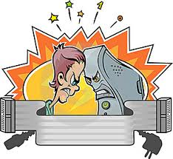
Human Intelligence VS Artificial Intelligence

Slide 37
Human Intelligence VS Artificial Intelligence
Pros
Human Intelligence
Artificial Intelligence
Intuition, Common sense, Judgement, Creativity, Beliefs etc
The ability to demonstrate their intelligence by communicating effectively
Plausible Reasoning and Critical thinking
Ability to simulate human behavior and cognitive processes
Capture and preserve human expertise
Fast Response. The ability to comprehend large amounts of data quickly.
Notes:
The important aspects of human intelligence seem to following the use of intuition, common sense, judgment, creativity, goal directedness, plausible reasoning, knowledge and beliefs.
Meaning of intelligence is not human brain’s information processing ability but the ability of humans to demonstrate their intelligence by communicating effectively.

Slide 38
Human Intelligence VS Artificial Intelligence
Cons
Human Intelligence
Artificial Intelligence
Humans are fallible
They have limited knowledge bases
Information processing of serial nature proceed very slowly in the brain as compared to computers
Humans are unable to retain large amounts of data in memory.
No “common sense”
Cannot readily deal with “mixed” knowledge
May have high development costs
Raise legal and ethical concerns

Slide 39
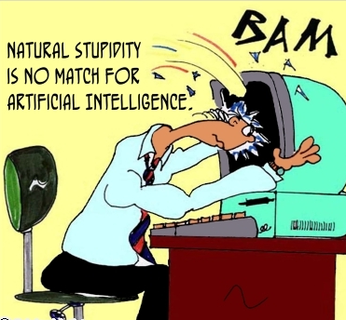
Human Intelligence VS Artificial Intelligence
We achieve more than we know. We know more than we understand. We understand more than we can explain (Claude Bernard, 19th C French scientific philosopher)

Slide 40
Artificial Intelligence VS Conventional Computing
Artificial Intelligence
Conventional Computing
AI software uses the techniques of search and pattern matching
Programmers design AI software to give the computer only the problem, not the steps necessary to solve it
Conventional computer software follow a logical series of steps to reach a conclusion
Computer programmers originally designed software that accomplished tasks by completing algorithms

Slide 41
What is Artificial Intelligence? (again)
Systems that think like humans
Cognitive Modeling Approach
“The automation of activities that we associate with human thinking...”
Bellman 1978
Systems that act like humans
Turing Test Approach
“The art of creating machines that perform functions that require intelligence when performed by people”
Kurzweil 1990
Systems that think rationally
“Laws of Thought” approach
“The study of mental faculties through the use of computational models”
Charniak and McDermott
Systems that act rationally
Rational Agent Approach
“The branch of CS that is concerned with the automation of intelligent behavior”
Lugar and Stubblefield
Notes:
Basic Framework...
Getting computers to do the right thing based on their circumstances and what they know!

Slide 42
How to Achieve AI?
AI
Acting humanly
Thinking rationally
Acting rationally
Thinking humanly

Slide 43
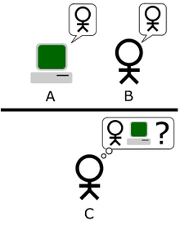
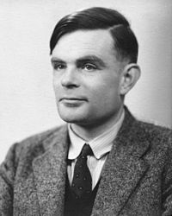
Acting Humanly: The Turing Test
http://en.wikipedia.org/wiki/Turing_test
+ physical interaction => Total Turing Test
Recognize objects and gestures
Move objects
Alan Turing
1912-1954
To be intelligent, a program should simply act like a human

Slide 44
Acting Humanly
The Turing Test (1950)
Can machines think?
Can machines behave intelligently?
Operational test for intelligent behavior
The Imitation Game
?
Human
Human
Interrogator
AI System

Slide 45
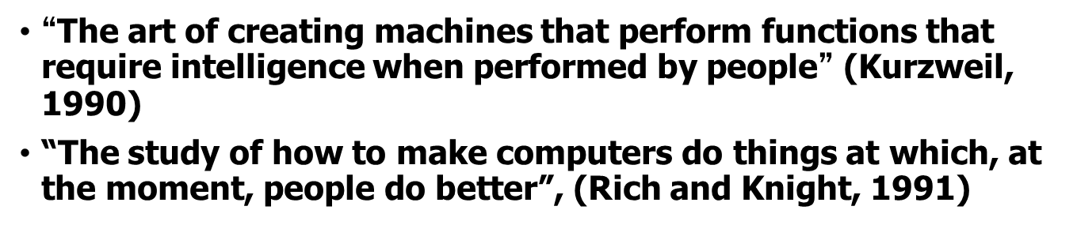
Acting Humanly
Turing Test (cont)
Predicted that by 2000, a machine might have a 30% chance of fooling a lay person for 5 minutes
Anticipated all major arguments against AI in following 50 years
Suggested major components of AI: knowledge, reasoning, language understanding, learning
Problem!
The turning test is not reproducible, constructive, or amenable to mathematical analysis

Slide 46
Acting Humanly – for Total Turing
To pass the Turing test, the computer/robot needs:
Natural language processing to communicate successfully.
Knowledge representation to store what it knows or hears.
Automated reasoning to answer questions and draw conclusions using stored information.
Machine learning to adapt to new circumstances and to detect and extrapolate patterns.
Computer vision to perceive objects. (Total Turing test)
Robotics to manipulate objects and move. (Total Turing test)
These are the main branches of AI.

Slide 47
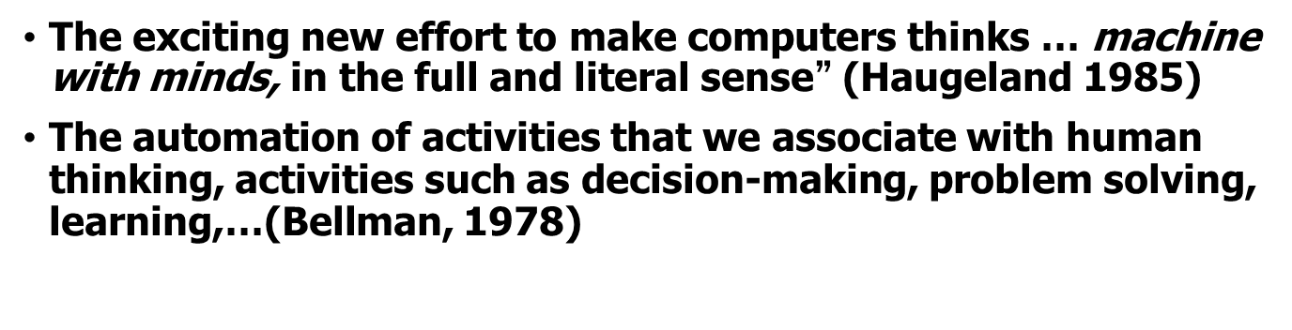
Thinking Humanly
1960’s cognitive revolution
Requires scientific theories of internal activities of the brain
What level of abstraction? “Knowledge” or “Circuits”
How to validate?
Predicting and testing behavior of human subjects (top-down)
Direct identification from neurological data (bottom-up)
Cognitive Science and Cognitive Neuroscience
Now distinct from AI

Slide 48
Thinking Humanly
Real intelligence requires thinking → think like a human !
First, we should know how a human think
Introspect ones thoughts
Physiological experiment to understand how someone thinks
Brain imaging – MRI…
Then, we can build programs and models that think like humans
Resulted in the field of cognitive science: a merger between AI and psychology.

Slide 49
Problems with Imitating Humans
The human thinking process is difficult to understand: how does the mind raises from the brain ? Think also about unconscious tasks such as vision and speech understanding.
Humans are not perfect ! We make a lot of systemic mistakes
We may think rationally but rarely act rationally

Slide 50
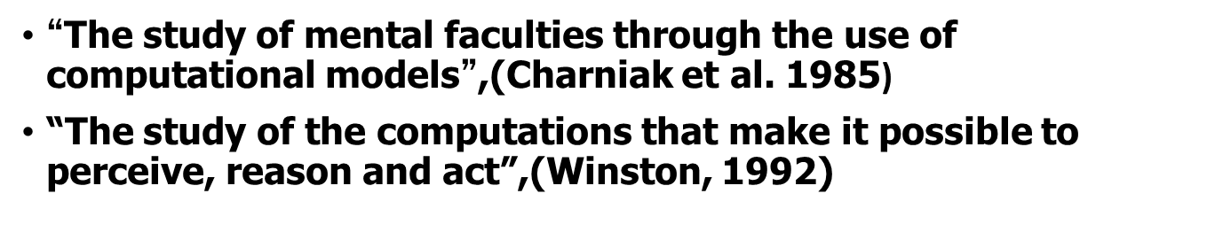
Thinking Rationally
Normative (or prescriptive) rather than descriptive
Aristotle: What are correct arguments / thought processes?
Logic notation and rules for derivation for thoughts
Problems:
Not all intelligent behavior is mediated by logical deliberation
What is the purpose of thinking? What thoughts should I have?

Slide 51
Thinking Rationally
Instead of thinking like a human : think rationally.
Find out how correct thinking must proceed: the laws of thought.
Aristotle syllogism: “Socrates is a man; all men are mortal, therefore Socrates is mortal.”
This initiated logic: a traditional and important branch of mathematics and computer science.
Problem: it is not always possible to model thought as a set of rules; sometimes there uncertainty.
Even when a modeling is available, the complexity of the problem may be too large to allow for a solution.

Slide 52
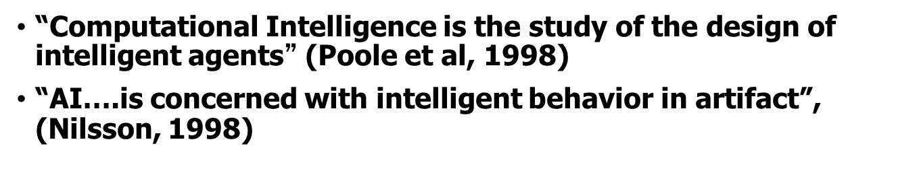
Acting Rationally
Rational behavior
Doing the right thing
What is the “right thing”
That which is expected to maximize goal achievement, given available information
We do many (“right”) things without thinking
Thinking should be in the service of rational action

Slide 53
Acting Rationally
Rational agent: acts as to achieve the best outcome
Logical thinking is only one aspect of appropriate behavior: reactions like getting your hand out of a hot place is not the result of a careful deliberation, yet it is clearly rational.
Sometimes there is no correct way to do, yet something must be done.
Instead of insisting on how the program should think, we insist on how the program should act: we care only about the final result.
Advantages:
more general than “thinking rationally” and more
Mathematically principled; proven to achieve rationality unlike human behavior or thought

Slide 54

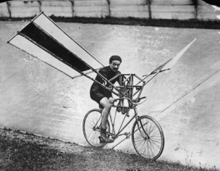
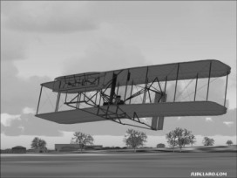
Acting Rationally
This is how birds fly
Humans tried to mimic
birds for centuries
This is how we finally achieved “artificial flight”

Slide 55
Relations to Other Fields
Philosophy
Logic, methods of reasoning and rationality.
Mathematics
Formal representation and proof, algorithms, computation, (un)decidability, (in)tractability, probability.
Economics
utility, decision theory (decide under uncertainty)
Neuroscience
neurons as information processing units.
Psychology/Cognitive Science
how do people behave, perceive, process information, represent knowledge.
Computer engineering
building fast computers
Control theory
design systems that maximize an objective function over time
Linguistics
knowledge representation, grammar
slide mostly borrowed from Max Welling

Slide 56
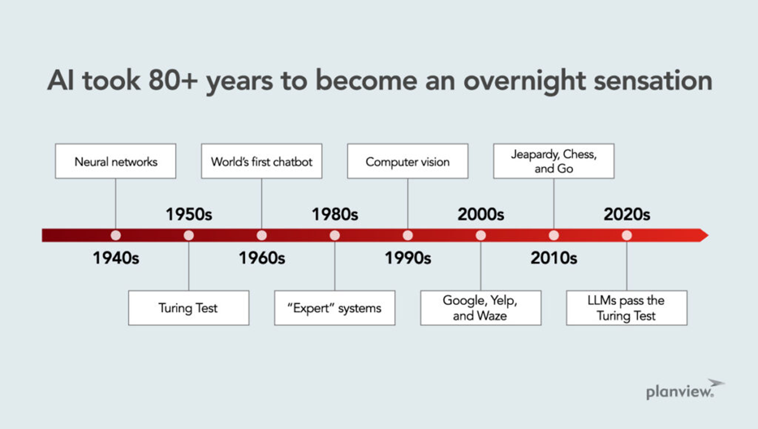

Slide 57
AI History
Gestation of AI (1934 - 1955)
In 1943, proposed a binary-based model of neurons
Any computable function can be modeled by a set of neurons
A serious attempt to model brain
1950, Turing’s “Computing Machinery and Intelligence ”: turing test, reinforcement learning and machine learning
The Inception of AI (1956)
Dartmouth meeting to study AI
an AI program ”Logic Theorist” to prove many theorems
Early Enthusiasm and great Expectation (1952-1969)
General Problem Solver imitates the human way of thinking
LISP (AI programming language) was defined
1965, Robinson discovered the resolution method – logical reasoning
AI Winter (1966-1973)
Computational intractability of many AI problems
Neural Network starts to disappear

Slide 58
AI History
Knowledge-based systems (1969-1979)
Use domain knowledge to allow for stronger reasoning
Becomes an Industry (1980-now)
Digital Equipment Corporation selling R1 “expert sytem”
From few million to billions in 8 years
The return of neural network (1986-now)
With the back-propagation algorithm
AI adopts scientific method (1987-now)
More common to base theorems on pervious ones or rigorous evidence rather than intuition
Speech recognition and HMM
Emergence of intelligent agent (1995-now)
search engines, recommender systems,….
Availability of very large data sets (2001 – now)
Worry more about the data

Slide 59
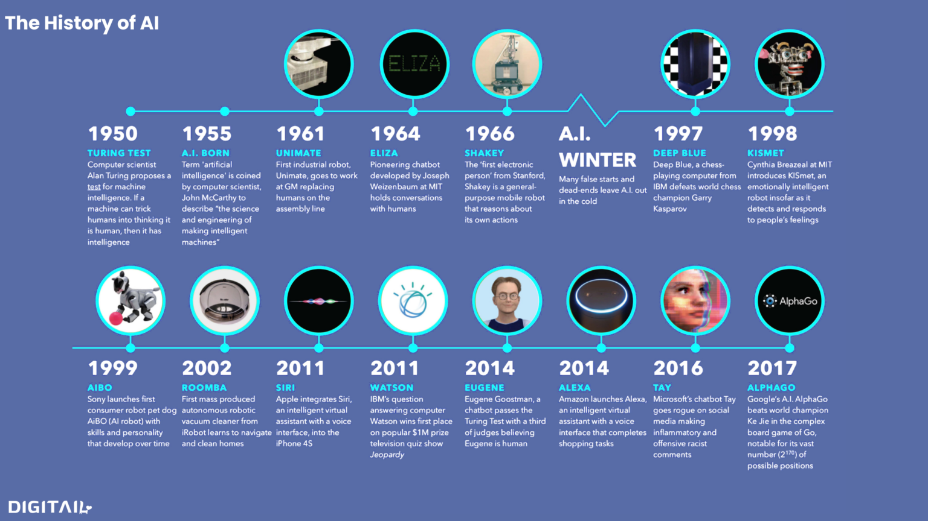

Slide 61
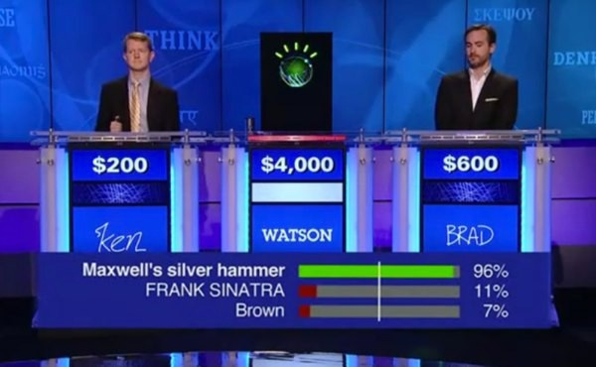
Question Answering
IBM Watson
Jeopardy! game player in January 2011
4 TB of data analyzed
Now used as a clinical decision support system, e.g., for lung cancer treatment

Slide 62
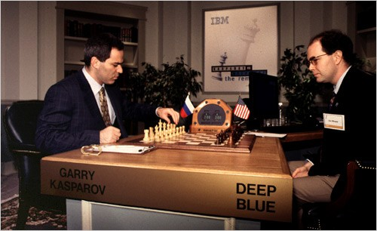
Game Playing: Chess
IBM Deep Blue vs. Kasparov, 1997/5
6 games: K, D, draw, draw, draw, D
IBM stock up $18 billion
Search: two-player zero-sum discrete finite games with perfect information.

Slide 63
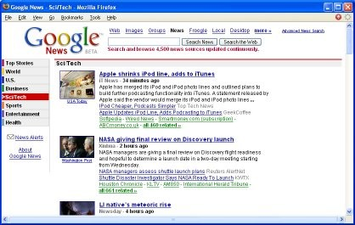
News Aggregation and Summarization
Automatically selects, summarizes, and arranges news from multiple sources
http://news.google.com
Unsupervised machine learning: clustering

Slide 64
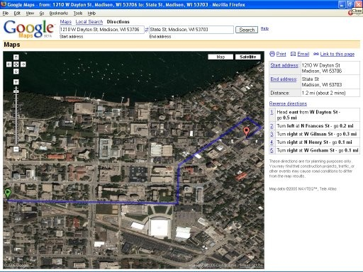
Navigation
Goggle Maps, Bing Maps, MapQuest
FedEx, UPS to plan package delivery
Search

Slide 65

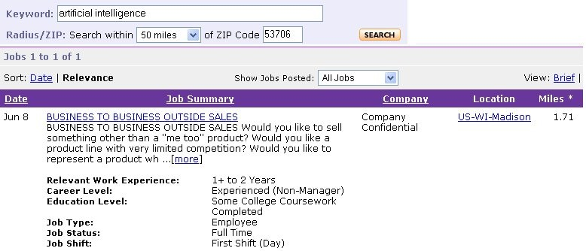
Web Information Extraction
Extract job info, free web text → DB
UW HAZY project: Extracts information from natural language text for knowledge base construction
Fill in missing information

Slide 66
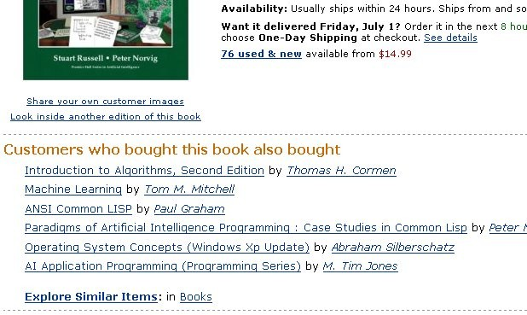

Collaborative Filtering
Recommendations based on other users’ behavior
e.g. Amazon
e.g. Netflix
Unsupervised learning

Slide 67
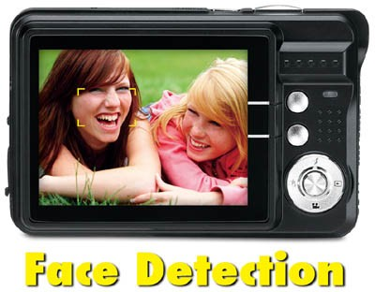
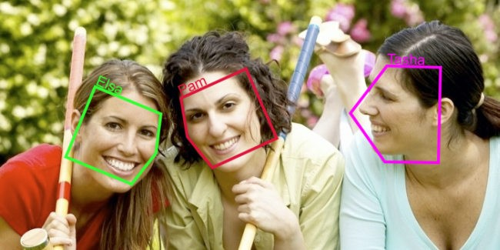
Face Detection and Recognition
Face Recognition: Autotagging photos in Facebook, Flickr, Picasa, iPhoto, …

Slide 68
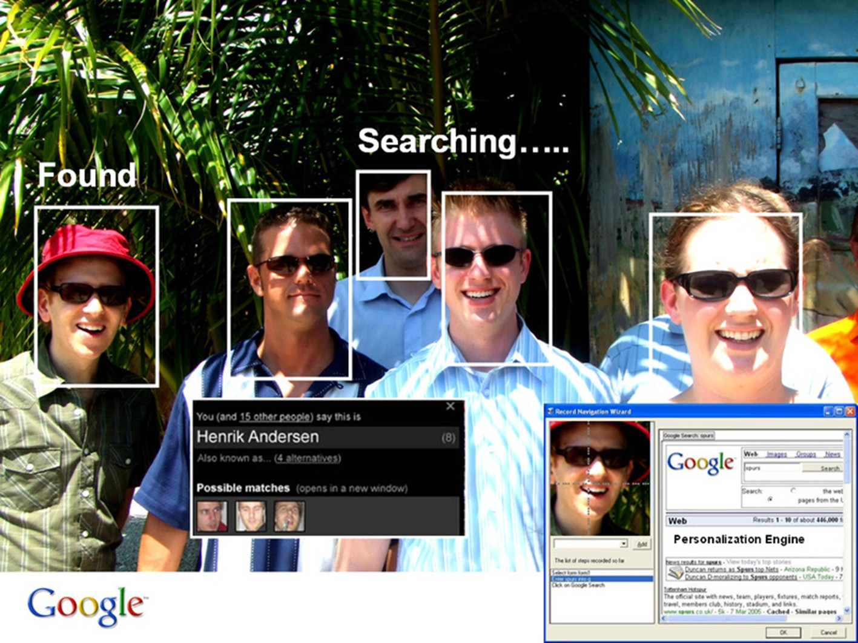
Face Recognition: Autotagging Photos in Facebook, Flickr, Picasa, iPhoto, …

Slide 69


Handwriting Recognition
When you deposit a check at an ATM, handwriting recognition automatically “reads” the amount
When you mail a letter, the USPS automatically reads the address and zip code

Slide 70

Flyable Cameras
DJI Phantom 2 Vision Quadcopter
$1,200 (January 2014)

Slide 71
Autonomous Robots
Key questions in mobile robotics
What is around me?
Where am I ?
Where am I going ?
How do I get there ?
Alternatively, these questions correspond to
Sensor Interpretation: what objects are in the vicinity?
Position and Localization: find your own position on a map (given or built autonomously) and position on road
Map building: how to integrate sensor information and your own movement?
Path planning: decide the actions to perform for reaching a target position

Slide 72


Space Exploration Robots
Driving on Mars by Sojourner, Spirit, Opportunity, and Curiosity rovers

Slide 73

Cleaning Robots
iRobot Roomba robot for vacuuming floors
Roomba demo

Slide 74

Lawn Mowing Robots
Robomow

Slide 75



Mine Mapping and Rescue Robots

Slide 76

Physical Assistants:
Robots to Help the Elderly and Impaired

Slide 77




Driverless Vehicles
Cars, airplanes, helicopters, birds, insects

Slide 78

Driverless Cars

Slide 79
Driverless Cars: What’s Needed?
Car Information
Position and orientation of car, velocity and turning rate of car
Environment Information
Where is the road, curb, road signs, stop signs, other vehicles, pedestrians, bicyclists, …
Actions
Velocity, steering direction, braking, …
Sensors
Video cameras, radar, LIDAR, GPS, …

Slide 80
Driverless Cars: Sensors
Video cameras
LIDAR (depth/range) sensor
times how long it takes a beam of laser light to bounce off something
gives 3D info on environment to 5 cm accuracy
Radar sensors on front and rear
Position sensor on wheel
GPS
Inertial motion sensor (IMU)
Position and orientation of vehicle updated in real- time with 50 cm position accuracy and 1/50 degree orientation accuracy

Slide 81

LIDAR-based Terrain Acquisition

Slide 82

Google’s Driverless Car

Slide 83
The Future of Autonomous Driving?
“In 20 years I will trust my autonomous car more than I trust myself”
Sebastian Thrun
“It won’t truly be an autonomous vehicle until you instruct it to drive to work and it heads to the beach instead.”
Brad Templeton

Slide 84
Progress in AI: 1956 – 2010
Human-Level Chess
100%
Human-Level Dialogue
40%
Human-Level Perception
10%
???

Slide 85


CAPTCHA
Completely Automated Public Turing test to tell
Computers and Humans Apart
Yahoo!
Google

